Slide 1

Title: Salary Predictions of Data Professions
Subtitle: Machine Learning Internship Project
Name: Omotayo Odunayo Juliana
Date: 15th June 2034

Slide 2

Introduction to Salary Predictions
Objective: Develop a predictive model for salaries of data professionals.
Importance: Helps job seekers understand potential earnings. Assists employers in setting competitive salaries.
Approach: Exploratory Data Analysis (EDA) Feature Engineering Model Development and Evaluation

Slide 3
Insights from Basic Statistics
Salary:
The average salary is approximately $58,137.
The minimum salary is $40,001, and the maximum is $388,112.
There is a wide range of salaries, indicating high variability.
Age:
The average age of employees is around 25 years.
The youngest employee is 21, and the oldest is 45.
The majority of employees are between 22 and 25 years old.
Experience:
The average past experience is about 1.6 years.
Many employees have no prior experience (minimum is 0).
The most experienced employee has 23 years of past experience.
Performance Ratings:
Ratings range from 2 to 5.
The average rating is about 3.5.
Leaves:
On average, employees have used about 23 leaves.
The remaining leaves range from 0 to 15, with an average of around 8.

Slide 4
Exploratory Data Analysis (EDA)
Histogram of Salary Distribution
Bar Chart of Average Salary by Designation
Scatter Plot of Salary vs Age and Experience
Box Plot of Salary by Unit

Slide 5
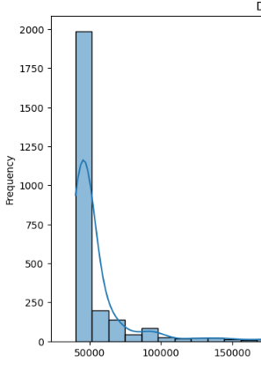
Visualizations Histogram of Salary
Distribution of Salaries:
The salary distribution is highly right-skewed, with a long tail towards high salaries.
The majority of employees have salaries clustered around the lower end (likely between $40,000 to $100,000).
There are relatively few individuals with very high salaries, creating the long tail.

Slide 6
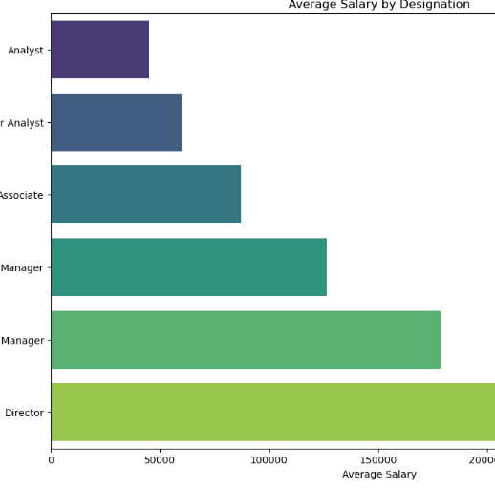
Bar Chart of Average Salary By DESIGNATION
Average Salary by Designation:
There is a clear hierarchical progression in average salaries from Analyst to Director.
Directors have the highest average salary, followed by Senior Managers.
Analysts have the lowest average salary.
The jump in average salary seems most significant between Manager and Senior Manager, and then again between Senior Manager and Director.

Slide 7
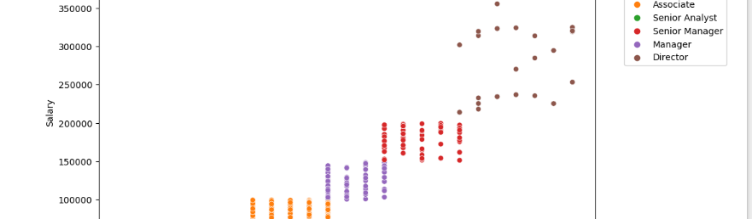
Scatter Plot of SALARY vs AGE
Salary vs Age:
Similar to experience, there is a positive correlation between age and salary.
Higher-level positions (Directors, Senior Managers) are generally held by older employees.
Younger employees (around age 20-25) are mostly Analysts with lower salaries.
There's a noticeable salary dispersion as age increases, with some older employees earning much more than others of the same age.

Slide 8
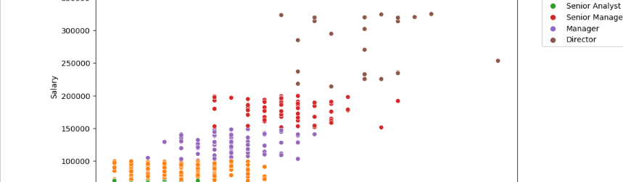
Scatter Plot of SALARY vs Past Experience
Salary vs Past Experience :
There is a clear positive correlation between past experience and salary across all designations.
Directors and Senior Managers tend to have higher salaries and more years of experience.
Analysts and Associates cluster at the lower end of both salary and experience.
There is significant salary variation even within the same years of experience, particularly for higher-level positions.

Slide 9
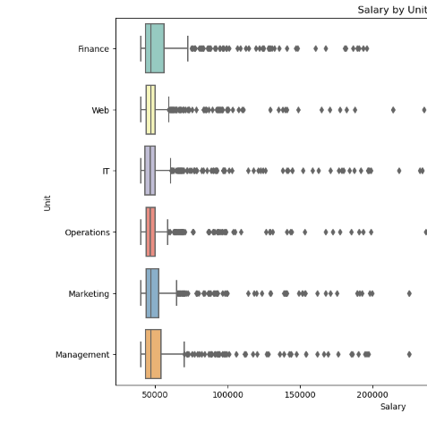
Box Plot of SALARY By UNIT
Salary by Unit :
All units have a wide range of salaries, indicated by the long whiskers on the box plots.
Finance seems to have the highest median salary, followed closely by Web and IT.
Operations and Marketing have slightly lower median salaries.
There are numerous outliers (high salaries) in most units, particularly in Finance, Web, and IT.

Slide 10
Feature Engineering
Created New Features:
TENURE: Time with the company (years).
LEAVE_UTILIZATION: Proportion of used leaves.
EXPERIENCE_LEVEL: Categorized past experience (e.g, Junior, Senior).
IS_MANAGER: Binary indicator for managerial roles.
Impact on Model Performance:
Improved interpretability.
Enhanced model accuracy.

Slide 11
Data Preprocessing
Handling
Handling Missing Values:
Fill numerical with median
Fill categorical with mode
Encoding
Encoding Categorical Variables:
One-hot encoding for Designation, Unit, Sex
Label encoding for Ratings
Scaling
Scaling Numerical Features:
StandardScaler

Slide 12

Model Development
Models Used
Linear Regression
Random Forest
Training Process
Split data into training and testing sets.
Trained models on training data.
Evaluated models on testing data.

Slide 13

Model Evaluation
Linear Regression
Mean Absolute Error (MAE): 4639.85
Mean Squared Error (MSE): 96748558.13
Root Mean Squared Error (RMSE): 9836.08
R-squared (R2): 0.9417
Random Forest
Mean Absolute Error (MAE): 4636.47
R-squared (R2): 0.93

Slide 14

Model Comparison
Performance Metrics Comparison:
Both models show similar MAE.
Linear Regression has a slightly higher R-squared value.
Insights:
Linear Regression: More interpretable, slightly better R2.
Random Forest: Robust, handles non-linearity better.

Slide 15

Recommendation
For Employers:
Use predictive models to set competitive salaries.
Consider factors like experience and role for salary adjustments.
For Job Seekers:
Understand the value of experience and performance.
Leverage insights for salary negotiations.

Slide 16

Conclusion
Summary of Key Findings
Developed models to predict salaries accurately.
Identified significant features affecting salaries.
Impact:
Provides actionable insights for employers and job seekers.
Enhances understanding of salary determinants in data professions

